Slide 1
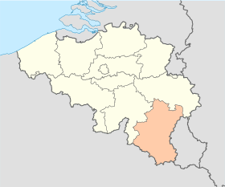
Vivalia / First site Proposal
7 sites integrated in Vivalia Group
5 hospitals
2 specialized centers
GERMANY
LUXEMBOURG
FRANCE

Slide 2
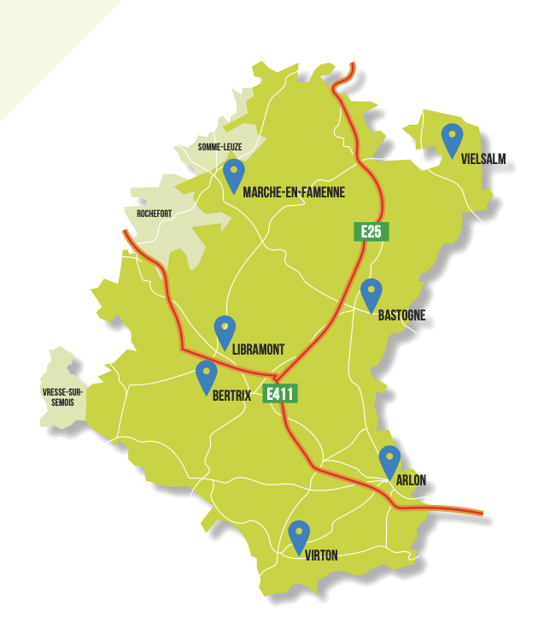
VIVALIA DATA
Beds with agreement = 1600
Beds outside = 410
Number admissions = 46.122
Number surgeries = 28.438
Stay days Hospital = 295.541
Stay days outside hospital = 127.864
Number of consultations = 325.817
Employees = 3.778
Doctors = 426
ICU = 12 + 14 + 4 = 30 Beds on 3 sites / EHR Metavision
Remark : Patients from France

Slide 3
STATUS
Ongoing signature of Dim3 installation and economical impact analysis
Each part supports its costs
SCOPE ANALYSIS
- First : confirm impact of reimbursement
- Secondary : users (Diet, Nurses, Doctors) satisfaction
Extra scopes, to be financed
DECISION : Baxter/Dim3 Confirm interest to use Vivalia as first site in the agreement
Attention points :
Adapt protocol
Extra scopes , to be financed

Slide 4




Vivalia + DIM3
ROADMAP
CONTRACT MANAGEMENT
Contract for Validation – Signature expected end of October
Acceptation by Direction and BOD
Budget définition Finalized
Ethic Comittee Ongoing
OPERATIVE ACTIONS
IT coordination : Start October
Coordination with EHR producer: Start November
Start Reimbursment impact part : January 2024
(current data deeper analysis to prepare evidence of economical assets )

Slide 5
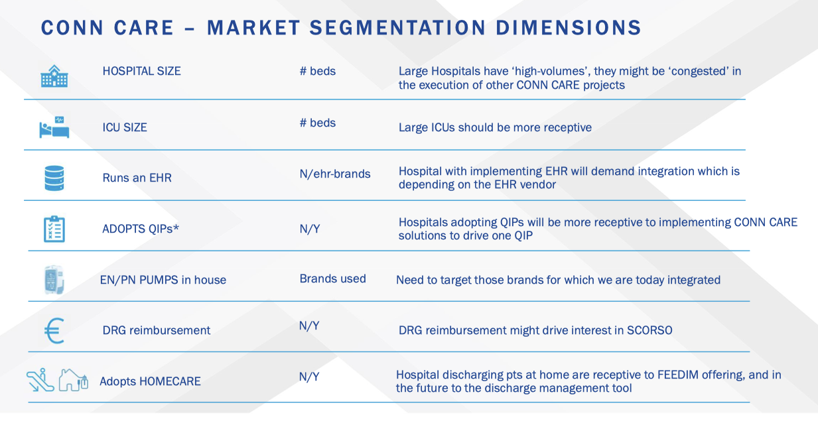
Does Vivalia fits ?
1600 beds
30 beds on 3 sites
Metavision ICU
Zorgi (Belgian EHR Leader)
Fresenius
Theoretical impact Dim3
known
Y + Remedus company

Slide 6
Go/non Go for selection Vivalia as Site 1

